Slide 1


Marketing Analysis Report
Group 6
By:
Binghong Xie
Guoqiong Sun
Haixian Liao
Shiru Xu
Yulin Zhang
Zihao Zhao

Slide 2
Content
Problem statement
Business Recommendations
Analysis
Exploratory data analysis
Regression on total consumption
Regression by products
Return of campaigns
ROI throughout the year
Conclusion
Business recommendations
Future directions

Slide 3
Problem Statement
Main Goal
- Identify which marketing program has the most impact on sales, thus, optimal the marketing spend.
- Identify the priority order of tactics
- Identify which marketing campaigns returned the most
- Identify when is the best time which has the highest ROI for sales tactics and marketing activation

Slide 4
Summary of Business Recommendation
The priority order of tactics are mass, feature, TPR (temporary price reduction), and large header only display
For media spending priority spend on Billboard and Influencer
For campaign spending, priority spend on Thanksgiving & Christmas holiday and Easter
For product, prioritize promotion on KH 12 CT Original and KH 24 CT Original
Each year, April and September seem to have the highest ROI for sales tactics and marketing activation

Slide 5
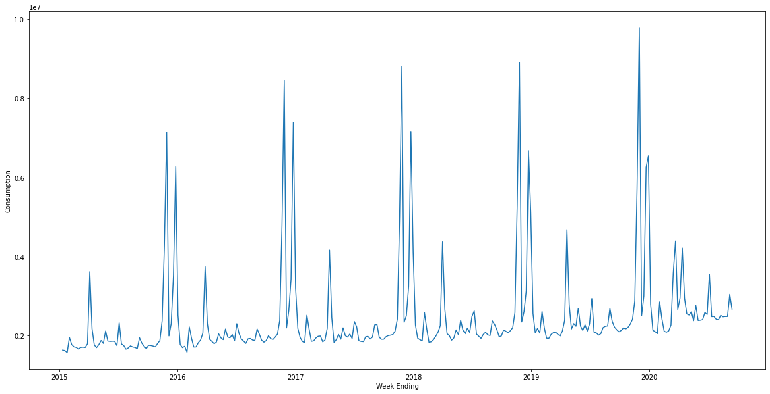
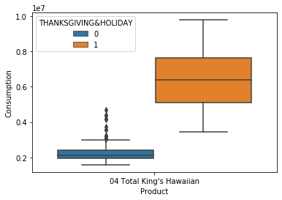
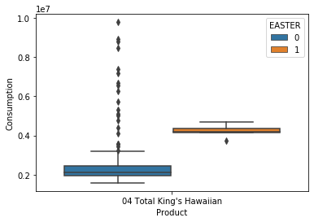
2016-2020 Consumption By Year EDA
Ex. Thanksgiving & Easter Consumption Difference
Total Consumption By Year
Notes:
We developed this consumption by year graph based on the given dataset called 2016-2020 consumption by week. And we can see from the above graph that the total consumption is slightly increasing each year with a few spikes in each year and the highest spike was at the end of year 2019.
And then we use the marketing campaigns in each year to find out the holiday period each year and set these holidays as dummy variables and we created barplots based on the dummys. We can tell by the two graphs on the right side that when holiday occurs, the mean of the consumption is a lot higher than without holidays.
Hence, we decided to dig deeper into the relationship between holiday campaigns and consumption and more details will be explained later.

Slide 6
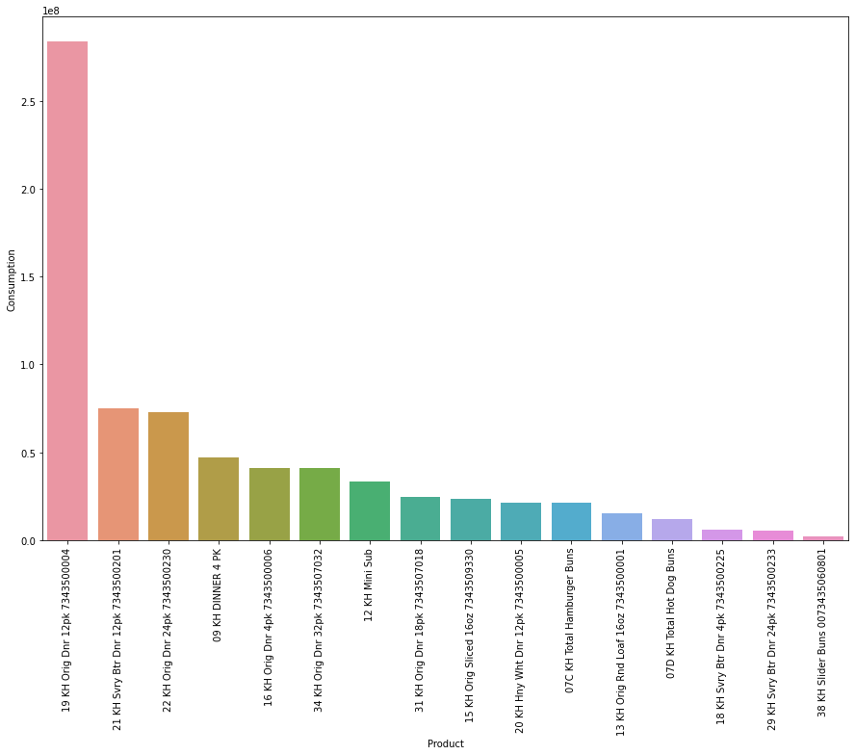
2016-2020 Consumption By Product EDA
Consumption by product
KH Orig Dnr 12pk has the highest consumption level
More details will be explained later by dashboard
Notes:
The graph is also developed based on 2016-2020 consumption by week. But instead we created the consumption by product graph and from the graph, we can see that the product called 19 KH orig 12 pk has the highest consumption value and it is a lot higher than the rest of other products.

Slide 7
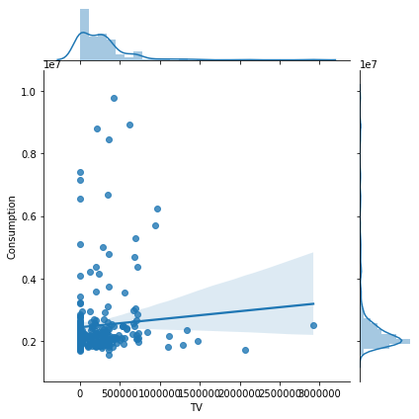
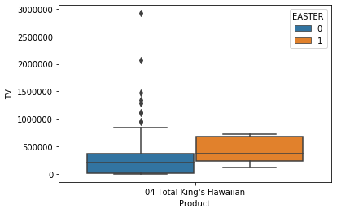
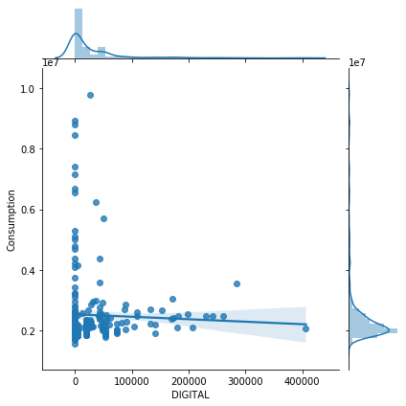
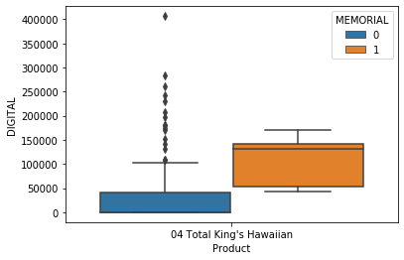
2016-2020 Campaign & Media Spending EDA
The mean of media spending is higher in Holidays
TV is positively correlated with consumption and Digital is negatively correlated with consumption
Media Spending with Holidays
Notes:
For these two barplots on the left, these are two examples of the relationship between media spending (ex. TV and digital) and products. When holiday comes up, the mean of media spending is higher but without holiday, the media spending has multiple outliers. And these two joingplots in the middle demonstrated the relationship between media spending (ex. TV and digital) and consumption. We can see that there are correlations between these two variables and we have decided to run regression analysis to test if it is statistically significant.

Slide 8
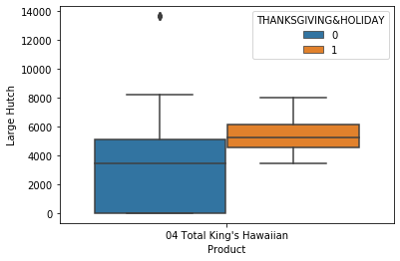
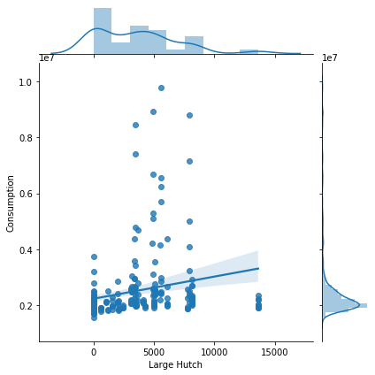
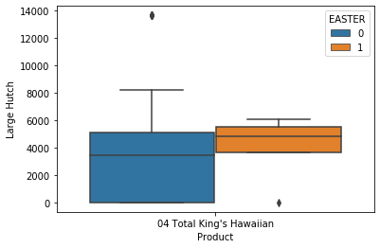
2016-2020 Campaign & Display EDA
When it comes to major holiday periods, the mean number of large hutch display is higher
Large Hutch display is positively correlated with consumption
Examples of Large Hutch (one kind of display)
Notes:
For these two barplots on the left, these are two examples of the relationship between display (ex. Large hutch) and products. When holiday comes up, the mean of media spending is higher than without holidays. And the jointplot in the middle demonstrated the relationship between display (ex.Large Hutch) and consumption. We can see that there are correlations between these two variables and we have decided to run regression analysis based on that. And more details will be talked about later.

Slide 9
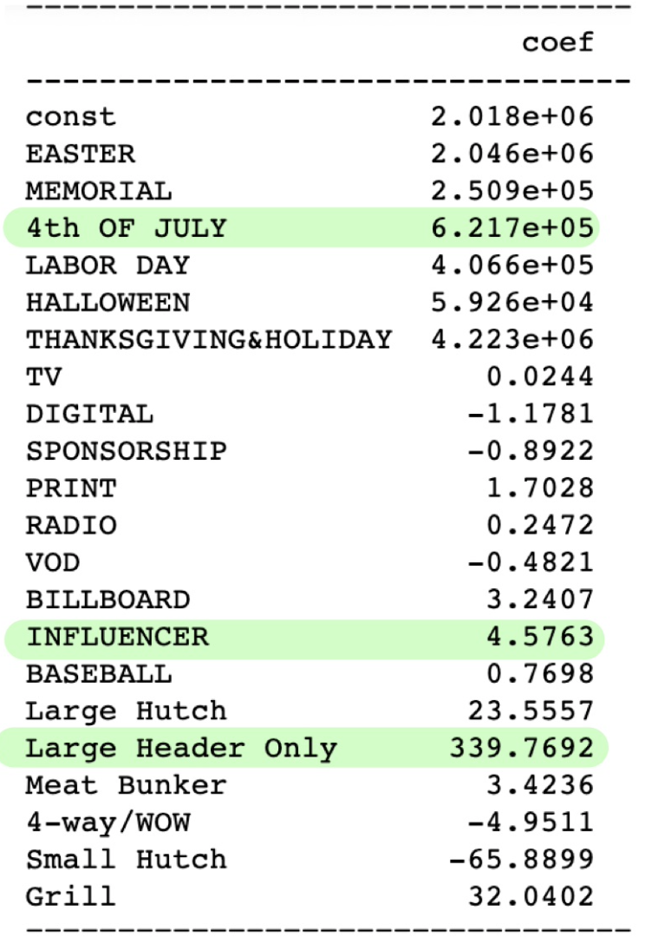
Regression
R-squared: 0.819
Positively Correlated with Consumption
All Holiday Campaigns
Largest Coefficient:
Holiday Campaigns: 4th of July
Media Spendings: Influencer
Displays: Large Header Only
Notes:
For this multiple linear regression model, we would like to use all holiday campaigns, media spendings, and displays to predict the Consumption. We measured media spending by dollar value and measured displays by quantity ordered. Holiday campaigns are dummies.
Since, we consider that campaigns and tactics may have delay effect on consumption, we adjust the data accordingly.
In our model, our independent variables explain almost 82% of variation in consumption.
All holiday campaigns are positively correlated with consumption. And their coefficients are extremely large. 4th of July relates the greatest increase in consumption.
Most of media spendings have positive relationship with consumption. Influencer relates the most increase in consumption
Similarly, most displays have positive correlation with consumption. Large Header Only relates the most increase in consumption.

Slide 10
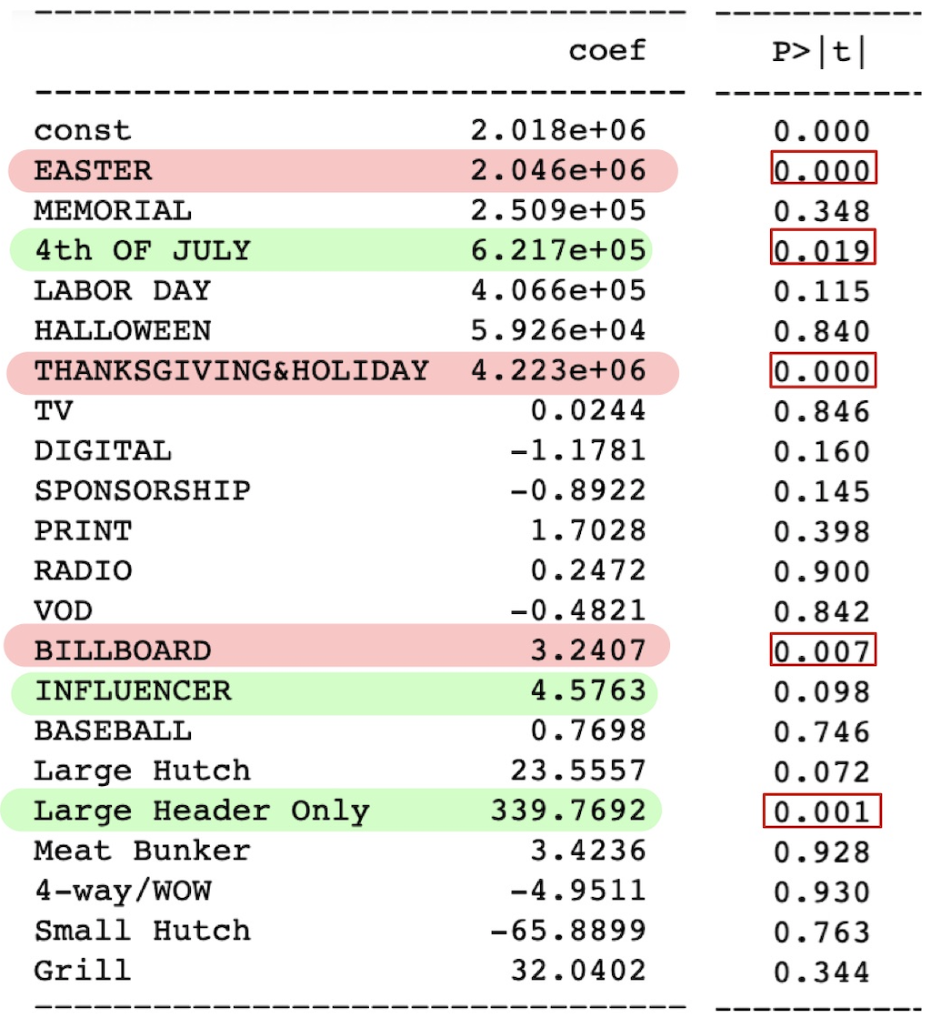
Regression
Significantly Positively Related to Consumption:
Holiday Campaigns
Easter
4th of July
Thanksgiving
Media Spending
BillBoard
Influencer (slightly significant)
Displays
Large Header Only
Large Hutch (slightly significant)
Notes:
Now let’s look at p-value.
Among all holidays, only easter, 4th of July and Thanksgiving have p-value less than 0.05. Therefore they are significantly positively related to consumption.
Among all media spendings, Billboard is significantly related to consumption. One more dollar investing in Billboard is correlated with about 3 units increase in consumption. Also, influencer is slightly significant.
Among all displays, Large Header Only is significant. Ordering one more Large Header Only display is correlated with 340 units increase in consumption. Also, Large Hutch is slightly significant.
Then we are wondering how each tactic affects specific product’s consumption. Thus, we did following regression analyses.

Slide 11
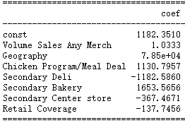
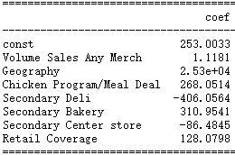
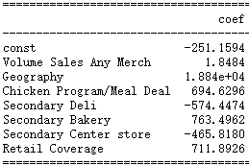
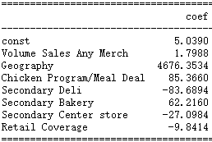
Product-specific Consumption Boosted By Tactics
Furthermore, we went a little bit deeper into the impact of each of tactics to examine how certain tactic would affect consumption for all products and how certain product would be affected by tactics.
KH 12 CT Original | KH 12 CT Butter | KH 24 CT Original | KH Round Bread
Notes:
The table above shows the contribution of each tactic to each of products.
For instance, the coefficient of Geography for KH 12 CT Original is 78500 suggests that on average, weekly volume sale in Walmart or Target would be about 78500 pounds higher than in other store.
Another example is that the coefficient of Chicken Program/Meal Deal for KH 12 CT Butter is about 310, which suggests that if chicken program/meal deal is implemented for the product, then it’s weekly volume sale would be increased by 310 pounds.

Slide 12
Information Presented in the Dashboard
Products:
Effective Tactics：
KH 12 CT Original
KH 12 CT Butter
KH 4 CT Original
KH Hamburger Buns
KH Hot Dog Buns
KH Sliced BreadD
KH 24 CT Original
KH Mini Subs
KH 18 CT
KH Slider Buns
Mass
Display
Feature
TPR
Feature&TPR
Chicken Program/Meal Deal
Secondary Deli
Secondary Bakery
Secondary Center Store
Retail Coverage
These tactics have relatively less significant impact on the volume sale than the first 5 tactics
Notes:
This slide shows the relationships between products and tactics.
We can see that each of products has multiple tactics that effectively boost its weekly in-store volume sale.
And each of tactics are positively affecting the volume sale of multiple products.

Slide 13
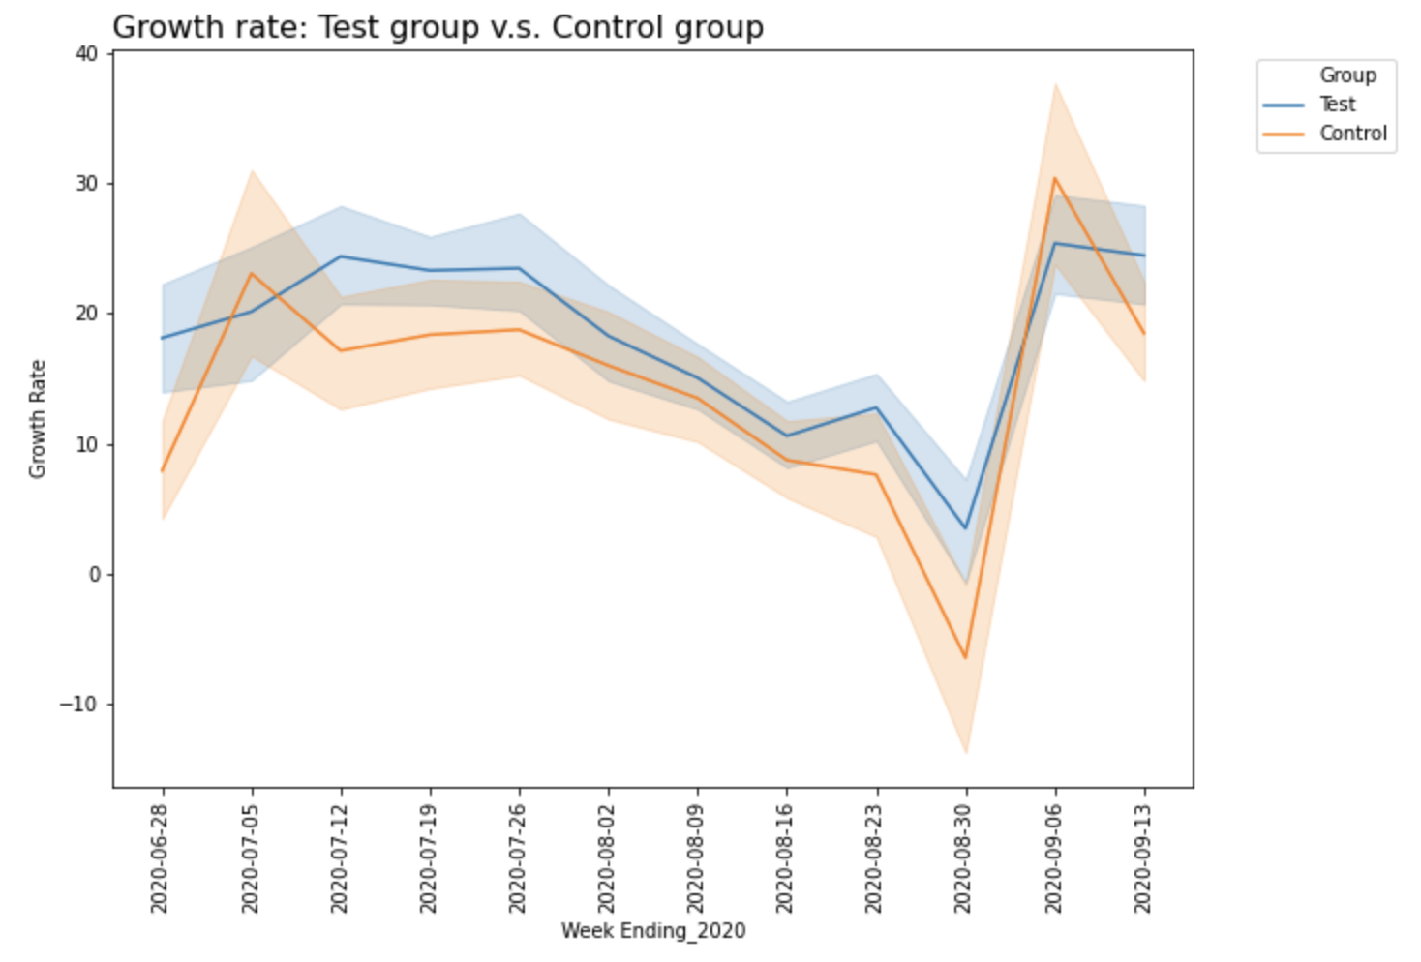
Digital Advertisements 2020
 | Avg. Growth rate
Test group (With digital advertisement) | 18.27%
Control group (W/o digital advertisement) | 14.44%
P-value | 0.00027
Average growth rate increased by around 4% when utilizing digital marketing.
Notes:
Since June-2020, only half of the regions have implemented digital advertisement, which is the test group.
Hence, the rest of the regions would be the control group.
For each week during the testing period, we calculated the growth rate compared to the same week in 2019.
The graph has shown that generally, test group’s avg growth rate is around 4% higher than control group.
While the p-value is below 0.05, we conclude that the difference is statistically significant.

Slide 14
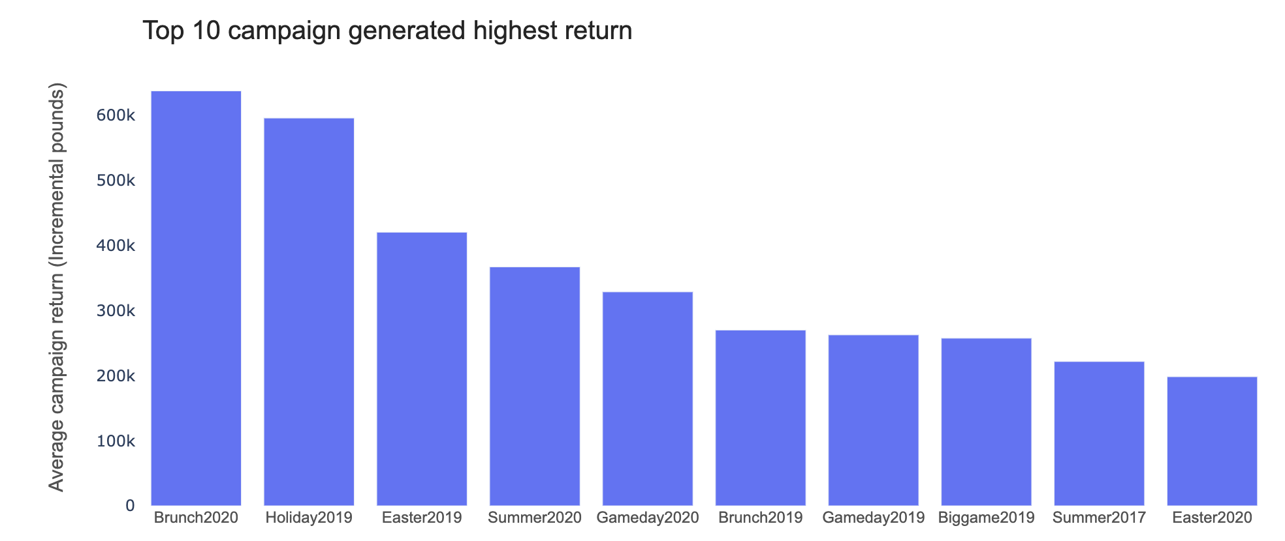
Return per campaign
Incremental consumption generated by tactics
Consumption= Intercept + β₁*Holiday + β₂*Media Spending + β₃*Display
Notes:
With the regression formula derived above, we are able to isolate the impact on consumption of each individual tactics (media spending and display), as well as other factors (Holidays).
Hence, we can calculate incremental consumption generated solely by marketing tactics, which is the return of tactics by the formula circled in the box.
With that, we calculated the average return during each campaign period and found that Brunch 2020, Holiday 2019 and Easter 2019 generated the highest return.

Slide 15
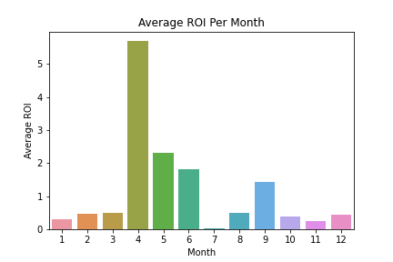
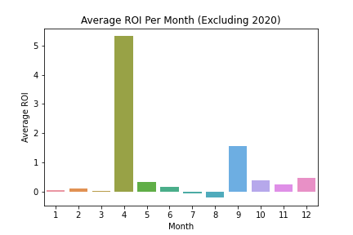
ROI throughout the year
ROI = Incremental consumption / total media spending
Notes:
ROI here equals to the return in the previous slide divided by total media spending of the week.
And after calculating the average ROI for each month, we found that April, May, June and September are the months with the highest ROI.
However, as the ROI in 2020 is affected by covid especially in the first half of 2020, hence we calculate again excluding 2020.
And consequently it shows that April and September would generally return significantly higher than other months throughout the year.

Slide 16
Conclusions - Business Recommendations
Tactics:
Prioritize media spending in Billboard, Influencer
Prioritize these promotion tactics - mass, feature, TPR (temporary price reduction), and display (large header only)
Prioritize promotions on KH 12 CT Original & KH 24 CT Original
Campaigns and Seasonality:
Prioritize campaign spending for Thanksgiving & Christmas holidays and Easter
Prioritize spending in marketing campaigns in April and September
Notes:
High-Level Summary: Overall, it is recommended that King’s Hawaiian prioritizes their spending on marketing tactics including billboard, influencer, mass, feature, TPR and display, on products including KH 12 CT Original & KH 24 CT Original, and also during the April, September, and some major holidays throughout the year, so that King’s Hawaiian can maximize the return and impact of their marketing campaigns. (If possible, KH should also increase spending efficiency during holidays because holiday campaigns have high return but not necessarily high ROI)

Slide 17
Conclusions - Future Directions
If we had more time and more data science knowledge, we would …
Analyze the relationship between the specific content of marketing and holidays
For example, which types of content in tweets can stimulate more consumption on holidays
Predict which products could become the next star products and how to promote them most effectively
Because KH 12 CT Original & KH 24 CT Original appear to be the two current star products, but KH 12 CT Butter & KH 18 CT seem to have a lot of potential
Predict the optimal amount of spending on each marketing tactic
As some marketing tactics are bringing in a large amount of incremental revenue , the more we spend on a tactic, the less marginal profit it may make

Slide 18
Thank You
We Appreciate Your Trust !

Slide 19
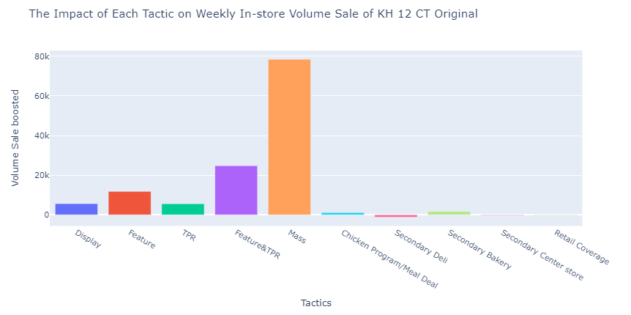
Appendix:
Graphs in the dashboard

Slide 20
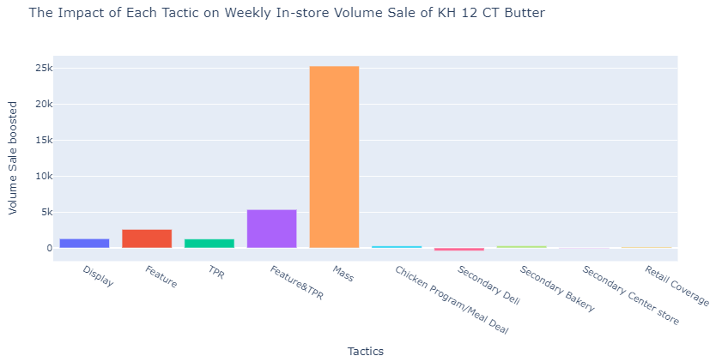
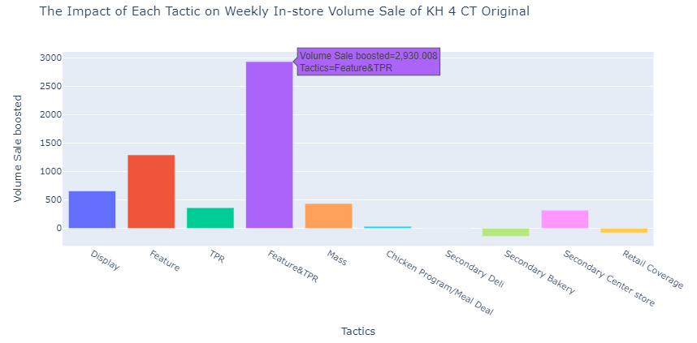

Slide 21
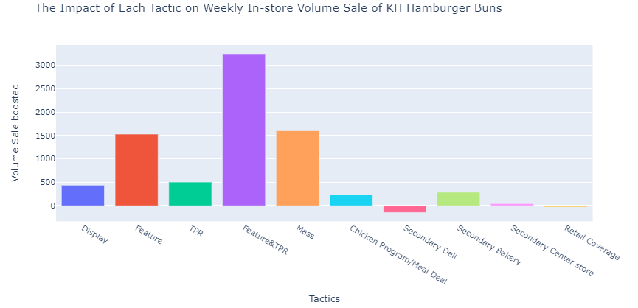
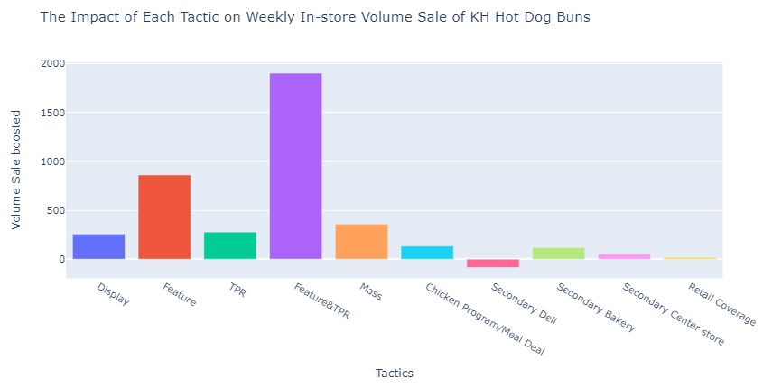

Slide 22
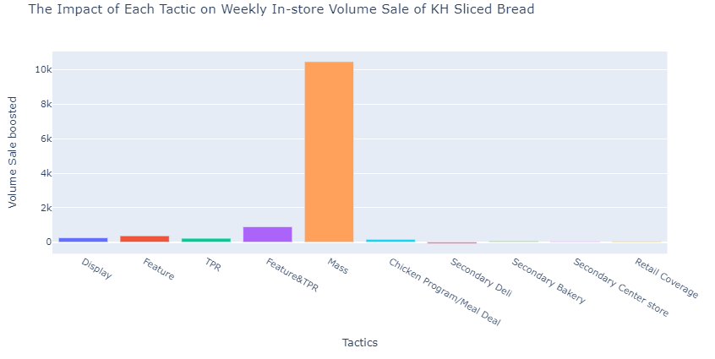
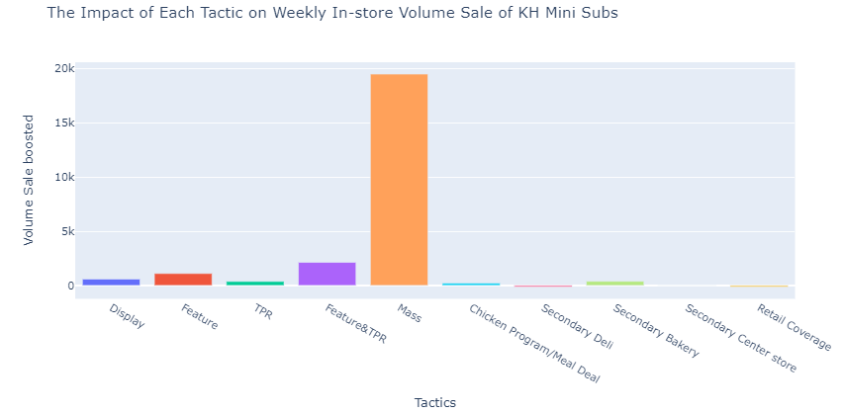

Slide 23
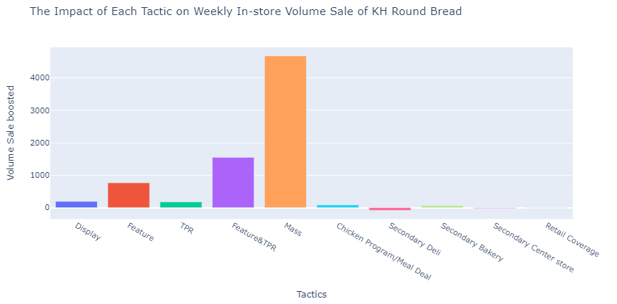
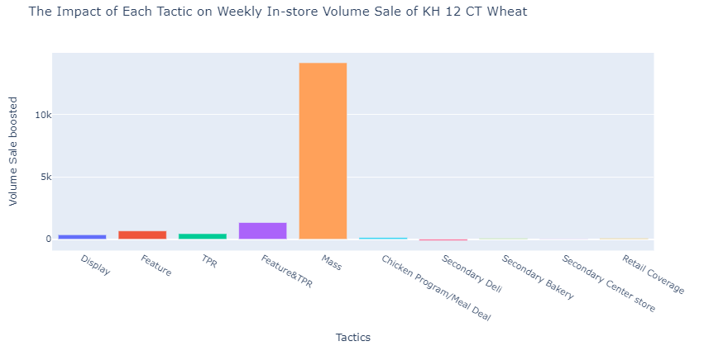

Slide 24
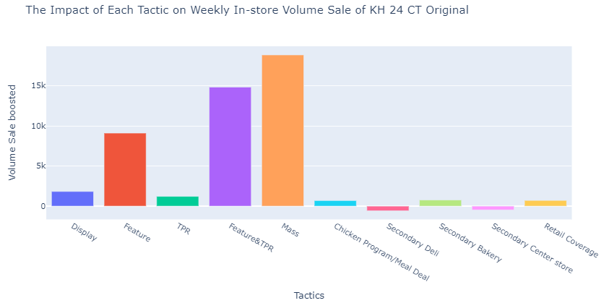
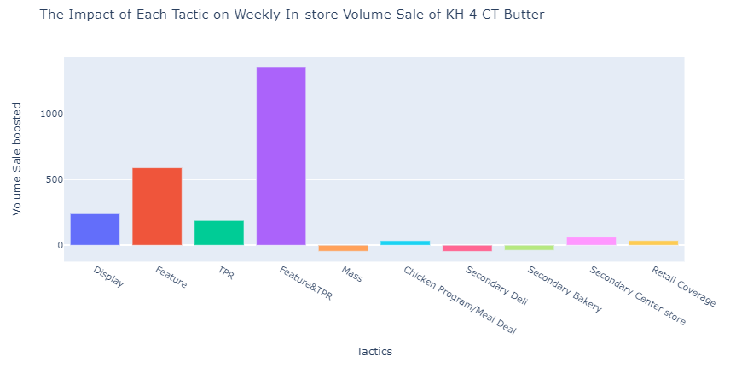

Slide 25
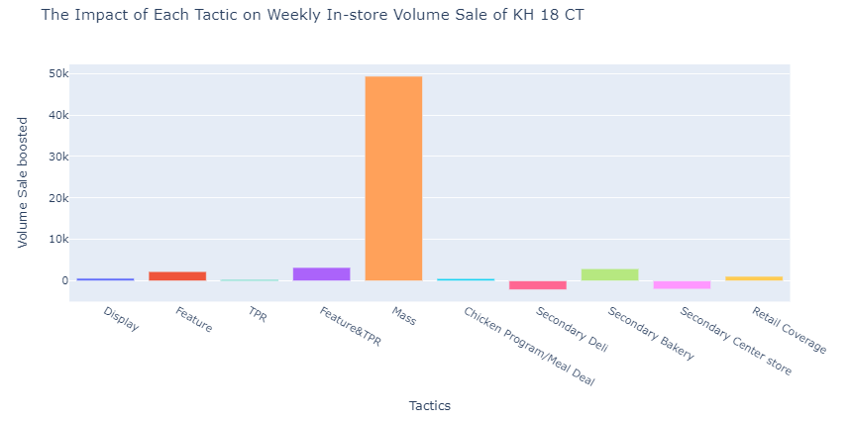
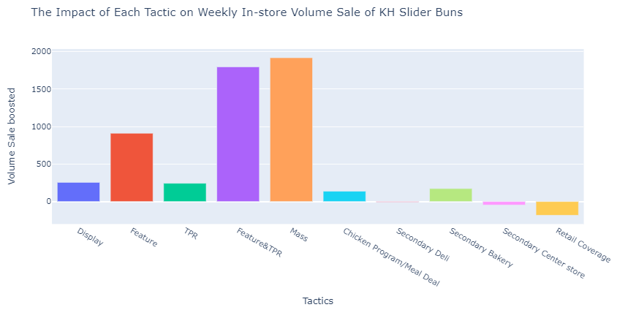

Slide 26
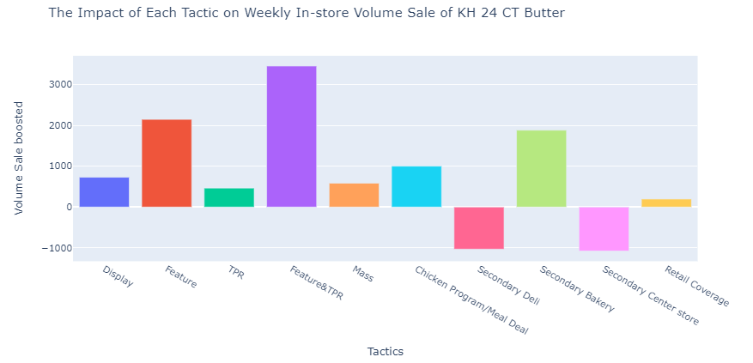
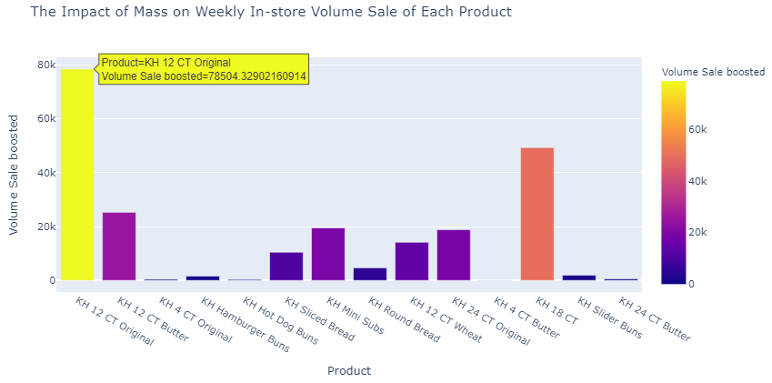

Slide 27
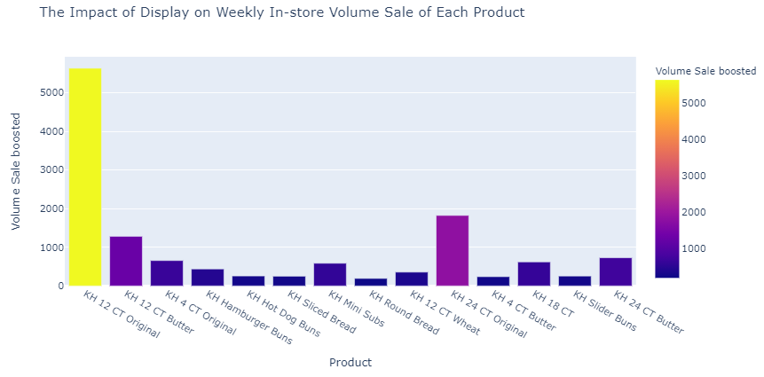
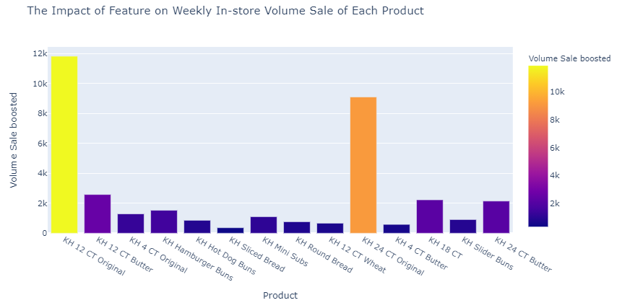

Slide 28
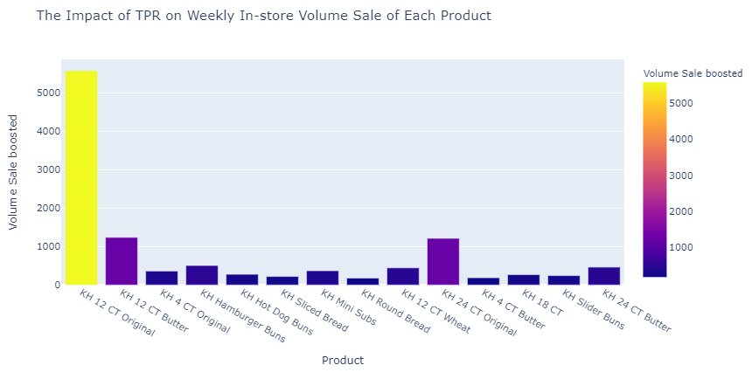
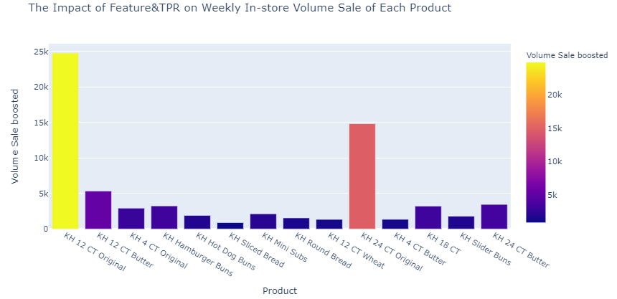

Slide 29
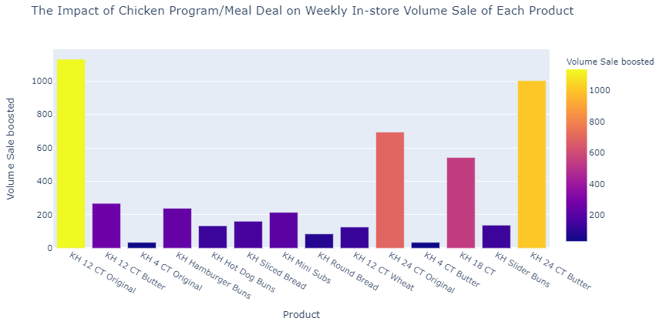
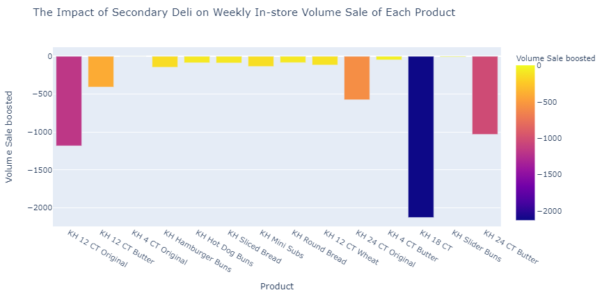

Slide 30
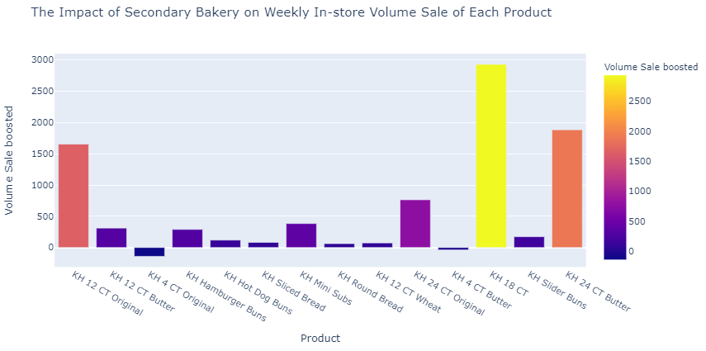
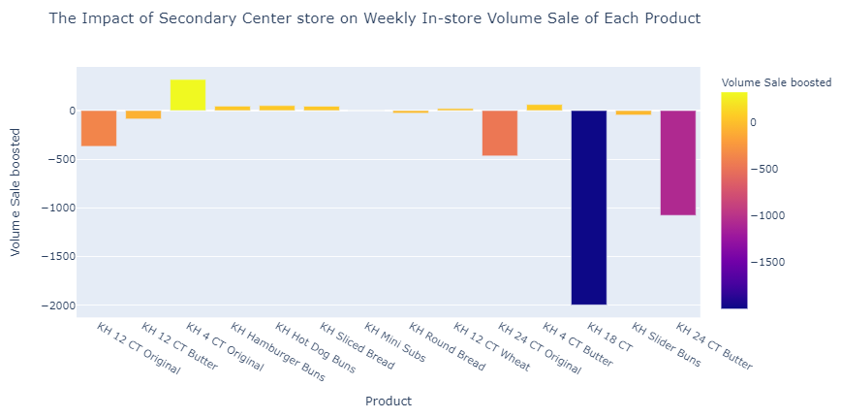

Slide 31
